Slide 2
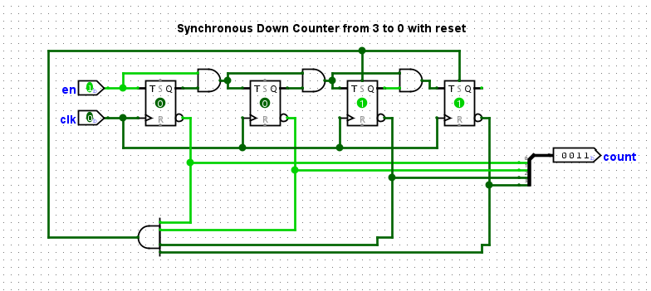
Down Counter From 3 to 0

Slide 3
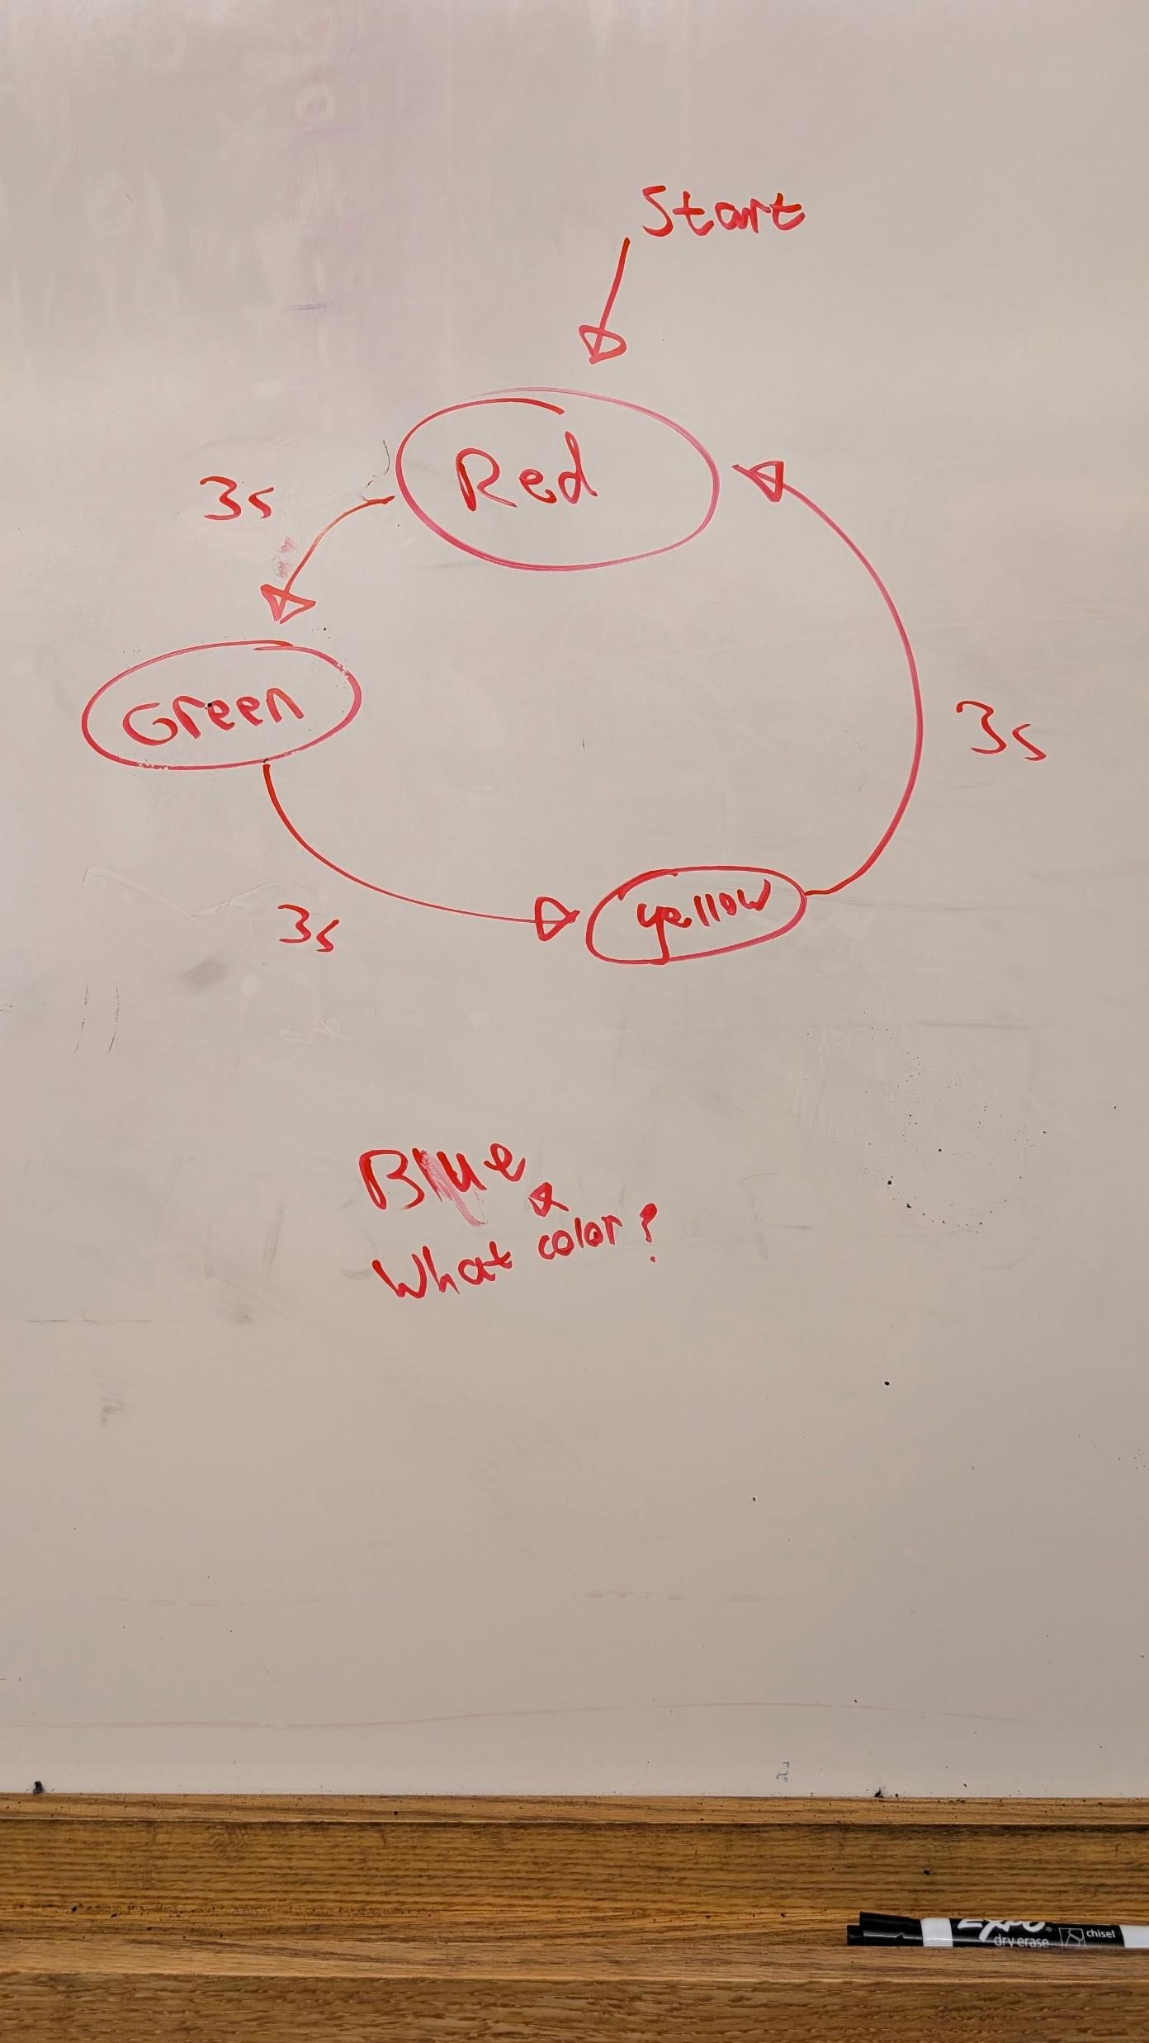
State Machine

Slide 4
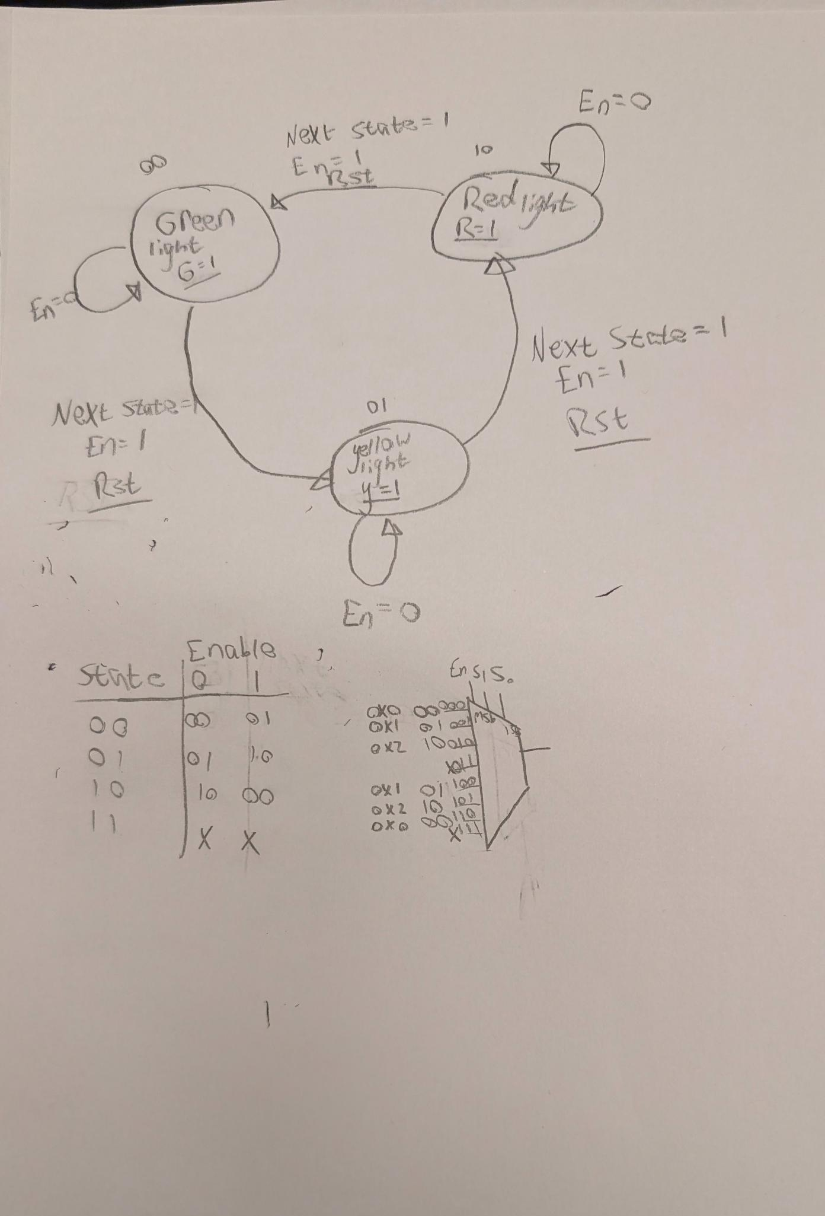
Modified State Diagram and Truth Table

Slide 5
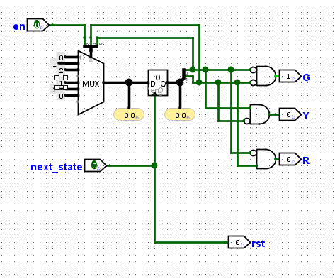
FSM Initial Design

Slide 6
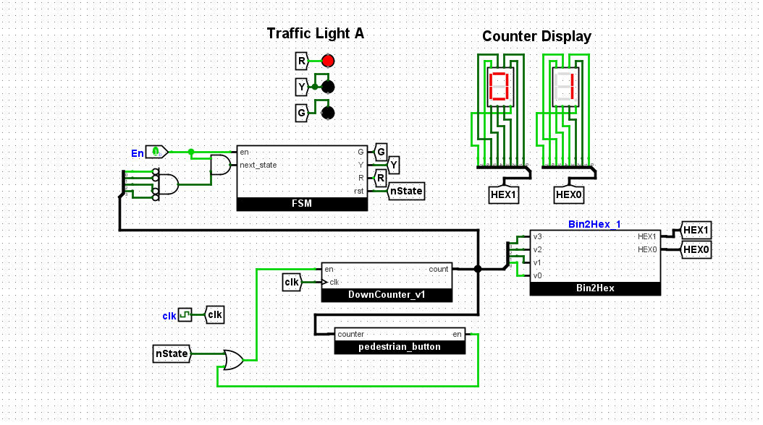
Functioning Traffic Light

